Slide 1

Presents a solution to BDAC database problem
Notes:
Good Afternoon ladies & gentleman, my name's redzwan, my team and I are representing Laksamana College of Business and we have decided to tackle Brunei Darussalam Aids Council's (BDAC) volunteer management problems.

Slide 2

BRUNEI DARUSSALAM AIDS COUNCIL (BDAC)
Problem:
Difficulty in tracking members and volunteers.
Notes:
we were supposed to pick just one problem to tackle but in BDAC's case the two problems were closely related, so we decided to kill two birds with one stone. We decided to create a database which will be connected to a smartphone app for volunteers to use.

Slide 3
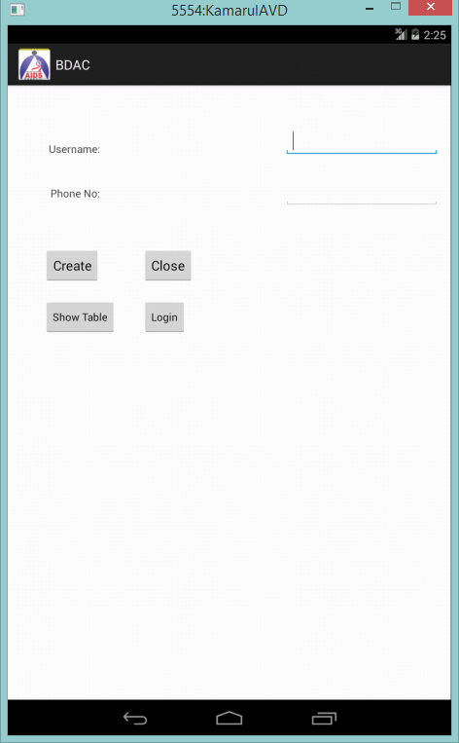
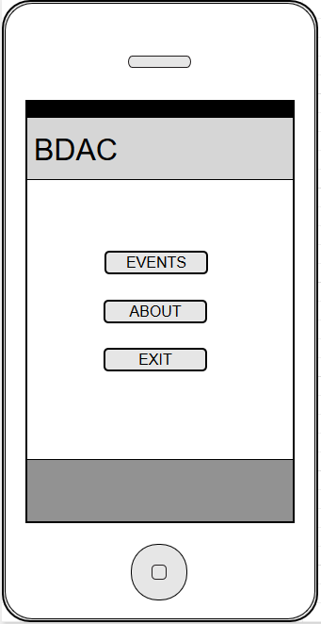
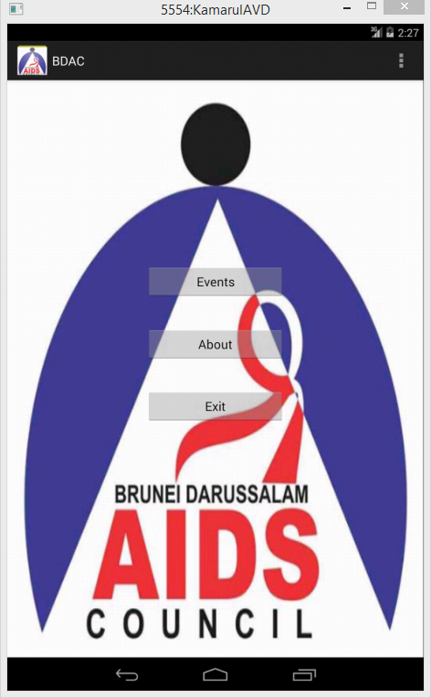
SOLUTION (Part 1)
Notes:
If you could please divert your attention to the screen, we have here a prototype of the application from the point of view of the end users. Volunteers will only need to do a one-time registration providing information such as their name, contact number, age, occupation, relevant skills that will be stored in the database. Once they have registered, the system will automatically generate a unique ID for each volunteer.

Slide 4
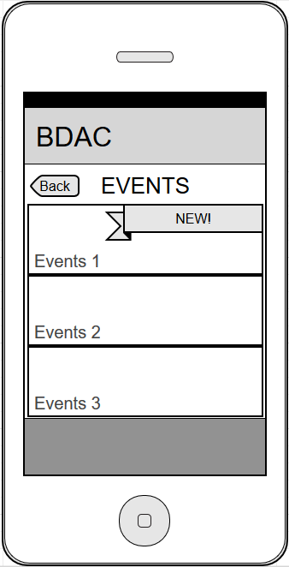
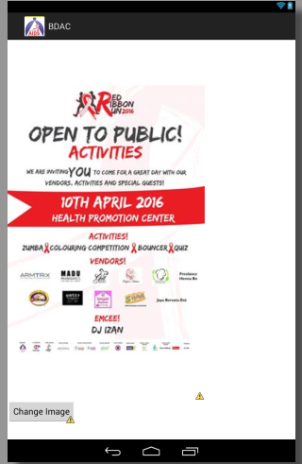
SOLUTION (Part 1)
Notes:
If you could please divert your attention to the screen, we have here a prototype of the application from the point of view of the end users. Volunteers will only need to do a one-time registration providing information such as their name, contact number, age, occupation, relevant skills that will be stored in the database. Once they have registered, the system will automatically generate a unique ID for each volunteer.

Slide 5
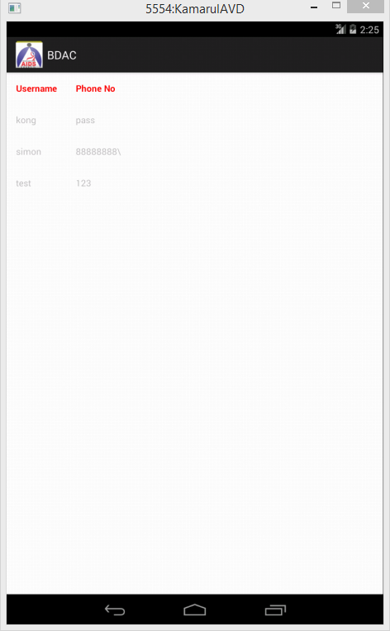
SOLUTION (Part 2)
Notes:
The main page of the app is a news feed of upcoming BDAC events. Volunteers will be alerted of new events through push notification, so they won't have to constantly check the app. Clicking on an event will bring them to an event page where they click a button to volunteer for the event.
The back end of the app is the database where the admin will be able to see a centralized record of registered volunteers. They can also see from here a list of volunteers who have indicated that they are available for an event. They can also filter volunteers by occupation, such as teachers, or skills, such as first aid skills, to select the best candidates for an event.

Slide 6
Value Proposition
Better communication leading to smoother running of education campaigns due to the implementation of a centralized database.
Notes:
Value proposition: Better communication leading to smoother running of education campaigns due to the implementation of a centralized database.
This solution is cost-effective (free actually) as there is no added machinery to buy or charge fee.

Slide 7
Future Steps Taken
Finalize prototype
Test prototype
Launch prototype
Notes:
For the future phase, we will be finalizing the prototype and implementing the database. testing and retesting and finally launching the app. if you would like to contact us here are our details. Thank you for your time.

Slide 8
Contact Us
Website: http://www.laksamanacollege.edu.bn/
LCB Phone Number: 2238816
Ask for: LCB COPs

